Slide 1


TITLE: Api security testing for payment applications
Name Reg.No
1 K.Sripad 23k91a6780
2 K.Sowmya 23k91a6786
3 N.Sidhartha 23K95A6710
4 K.Sathish 23K91A6792
Guide Name
MS. T. Jyothi
CSE (DATA SCIENCE)

Slide 2
INTRODUCTION
UPI and digital payment applications rely on APIs for secure communication between users, banks, and payment services. As digital payments grow, these APIs become major targets for cyberattacks.
Existing API security testing is largely manual and requires technical expertise to identify vulnerabilities. This makes the testing process time-consuming and less accessible for developers.
The proposed system automates API security testing using the OWASP API Security Top 10 framework. It also simulates replay attacks, duplicate payments, and amount-manipulation attacks.
CSE (DATA SCIENCE)

Slide 3
ABSTRACT
Provides an automated API security testing system for UPI and digital payment applications.
Detects common vulnerabilities such as broken authentication, BOLA/IDOR, injection, excessive data exposure, and rate-limiting weaknesses.
Simulates payment-specific security attacks including negative amounts, duplicate payments, replay attacks, unauthorized transactions, and expired tokens.
Generates a security score and detailed vulnerability report with severity levels and recommendations to improve payment API security.
CSE (DATA SCIENCE)

Slide 4
Existing system
API security testing for UPI and payment applications is commonly performed through manual penetration testing or separate security tools.
Existing tools often require technical expertise, manual configuration, and significant effort to identify API vulnerabilities.
Common security issues such as broken authentication, BOLA/IDOR, excessive data exposure, injection, and rate-limiting weaknesses may remain undetected.
Existing approaches may not provide a payment-specific security analysis, overall security score, and consolidated vulnerability report for developers.
CSE (DATA SCIENCE)

Slide 5
Limitation of Existing system
Manual API security testing increases testing effort and processing time.
Existing tools require technical expertise and manual configuration to identify vulnerabilities.
Existing approaches may have limited coverage of payment-specific attacks and transaction security.
Some tools lack a simple security score and consolidated report, making it difficult to quickly assess API security.
CSE (DATA SCIENCE)

Slide 6
Proposed System
The proposed system is an automated API security testing tool for UPI and payment applications.
It scans REST API endpoints to identify broken authentication, unauthorized access, excessive data exposure, rate-limit issues, and injection attacks.
The system automatically analyzes API requests and responses, identifies vulnerabilities, and assigns severity levels.
It generates an overall API security score and detailed security report with recommendations to fix detected vulnerabilities.
CSE (DATA SCIENCE)

Slide 7
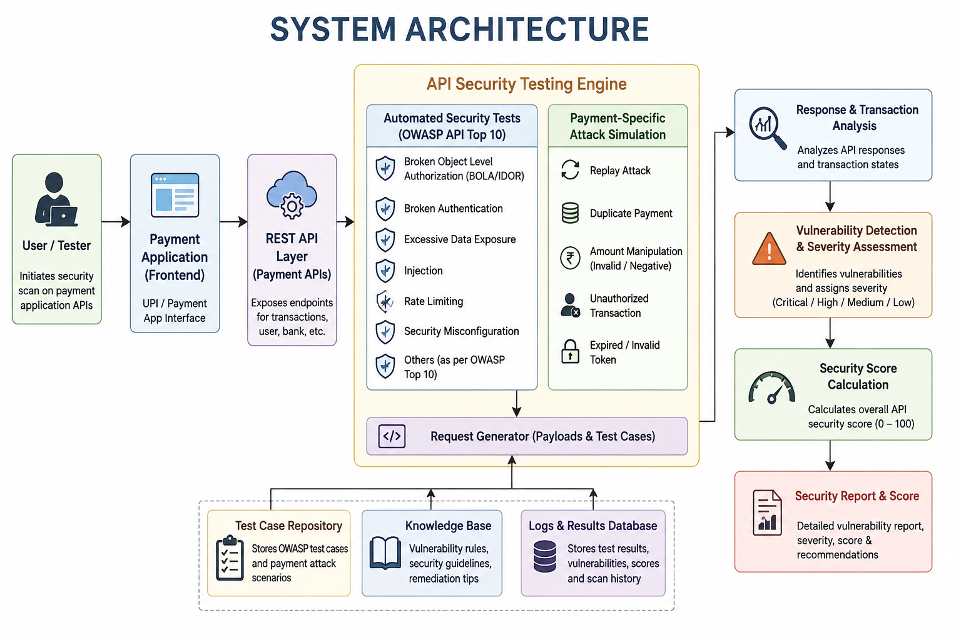

Slide 8
METHODOLODY
API Preparation: Create a dummy UPI/payment application with REST APIs for login, transactions, balance, and refunds.
Security Test Generation: Generate normal and malicious API requests based on the OWASP API Security Top 10 and payment-specific attack scenarios.
Automated Testing: Execute tests for authentication, BOLA/IDOR, injection, rate limiting, replay attacks, duplicate payments, and amount manipulation.
Analysis & Reporting: Analyze API responses and transaction states, identify vulnerabilities, assign severity, calculate the security score, and generate a detailed security report with recommendations.

Slide 9
SYSTEM REQUIREMENTS
HARDWARE
SOFTWARE
Processor: Intel Core i5 / AMD Ryzen 5 or higher
RAM: 8 GB minimum
Storage: 256 GB SSD minimum
Display: Full HD (1920 × 1080)
Network: Wi-Fi / Ethernet Internet connection
Operating System: Windows 10/11
Frontend: React.js, HTML, CSS, JavaScript
Backend: Java + Spring Boot
AI/NLP: Python
Database & Security: MySQL, OWASP ZAP, Postman

Slide 10
Conclusion
Enhances Payment Security: Detects vulnerabilities in payment APIs using OWASP security standards.
Automated Testing: Reduces manual security testing by automating API vulnerability detection.
AI-Based Analysis: Uses AI/NLP to analyze vulnerabilities and provide understandable security insights.
Improves Reliability: Helps developers identify and fix security issues before deployment.
CSE (DATA SCIENCE)

Slide 11

CSE (DATA SCIENCE)

